Slide 1
K-means Clustering Analysis
LK edge-deletion weight heatmap
AF strain-deletion weight heatmap

Slide 2
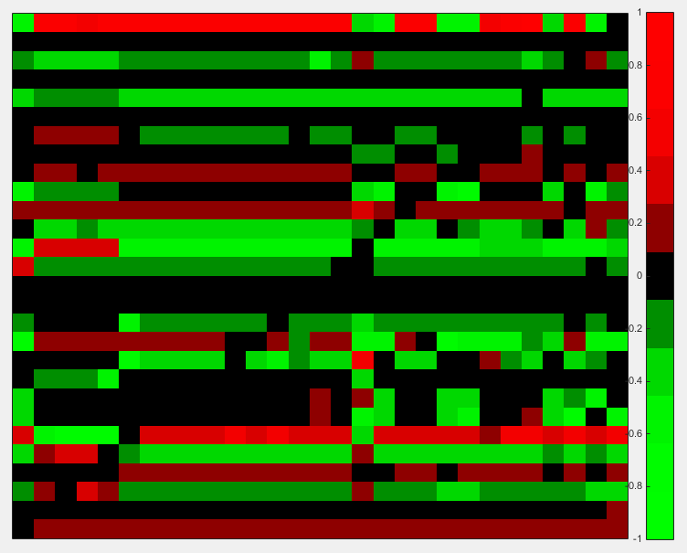
Heat map generated using MATLAB.
Data used were the optimized weights from the edge deletion study by Lauren Kelly.

Slide 3
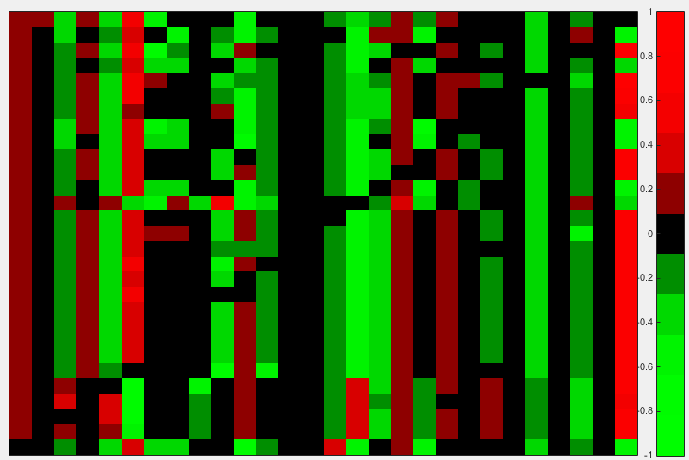
Transposed heat map from MATLAB.
LK weight data used.

Slide 4
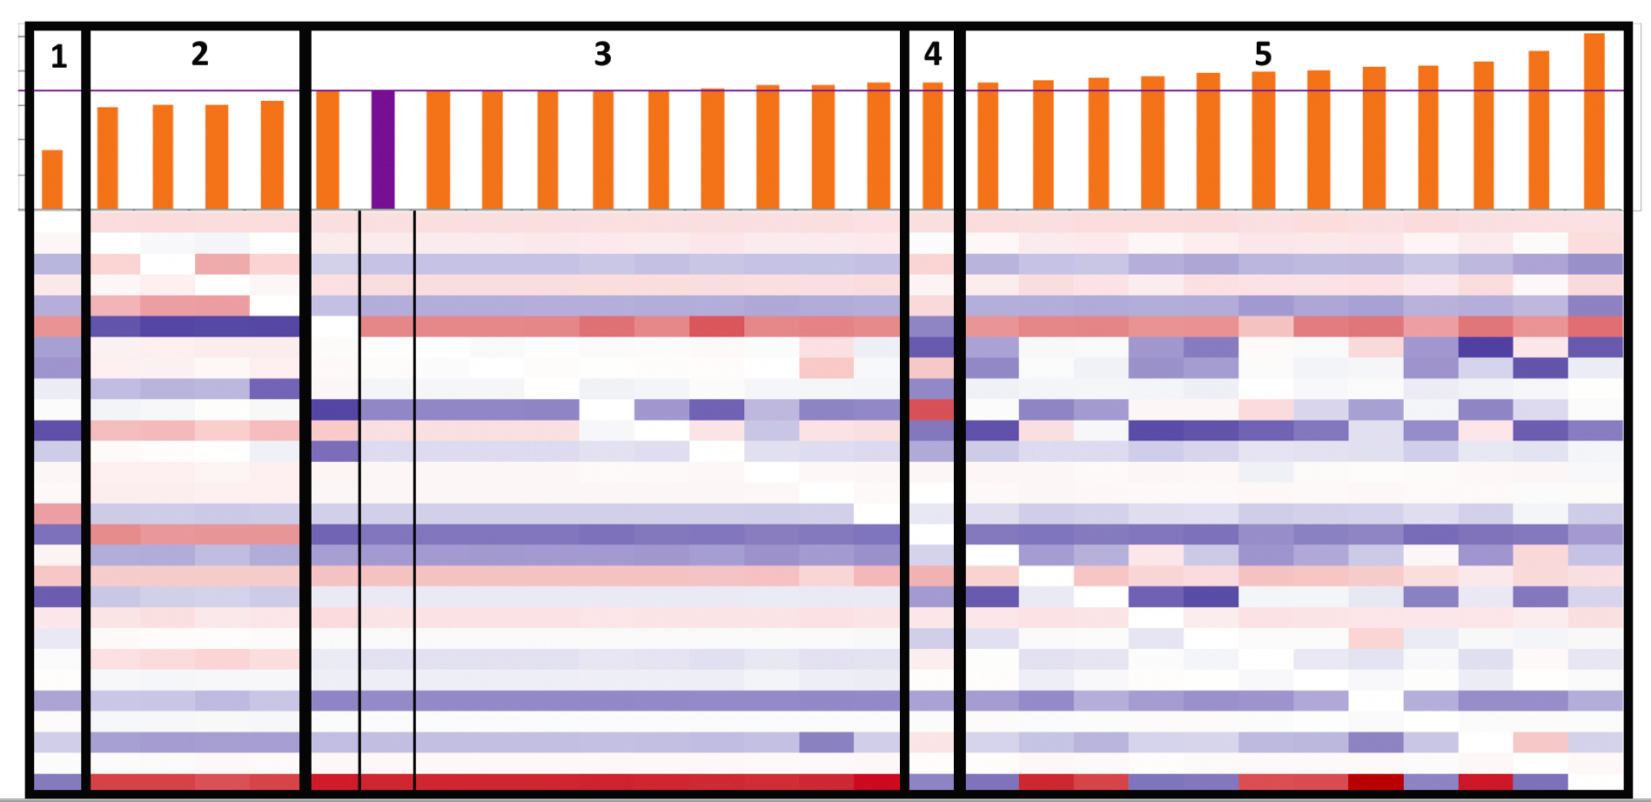
Edge-deletions sorted by increasing LSE:minLSE ratio, clustered by eye

Slide 5
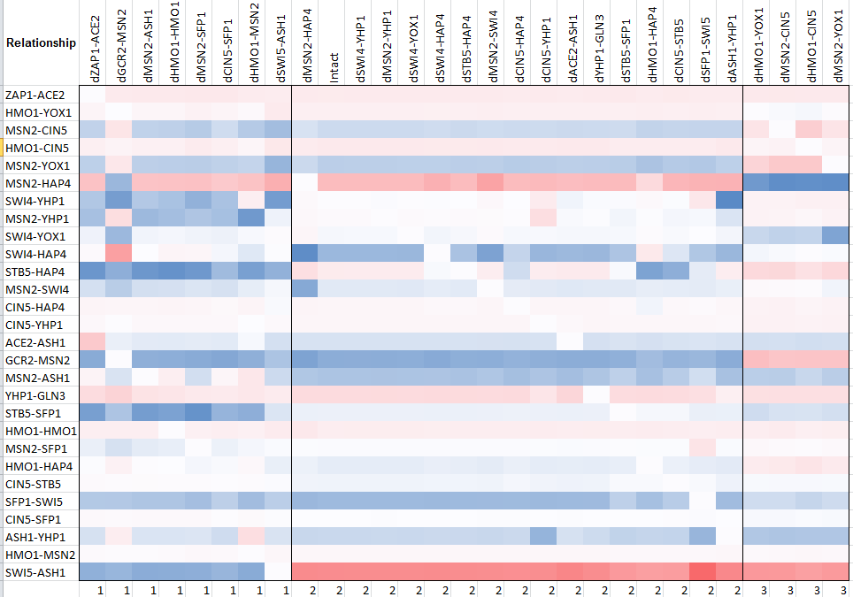
K means clustering: specified only 3 clusters

Slide 6


Slide 7
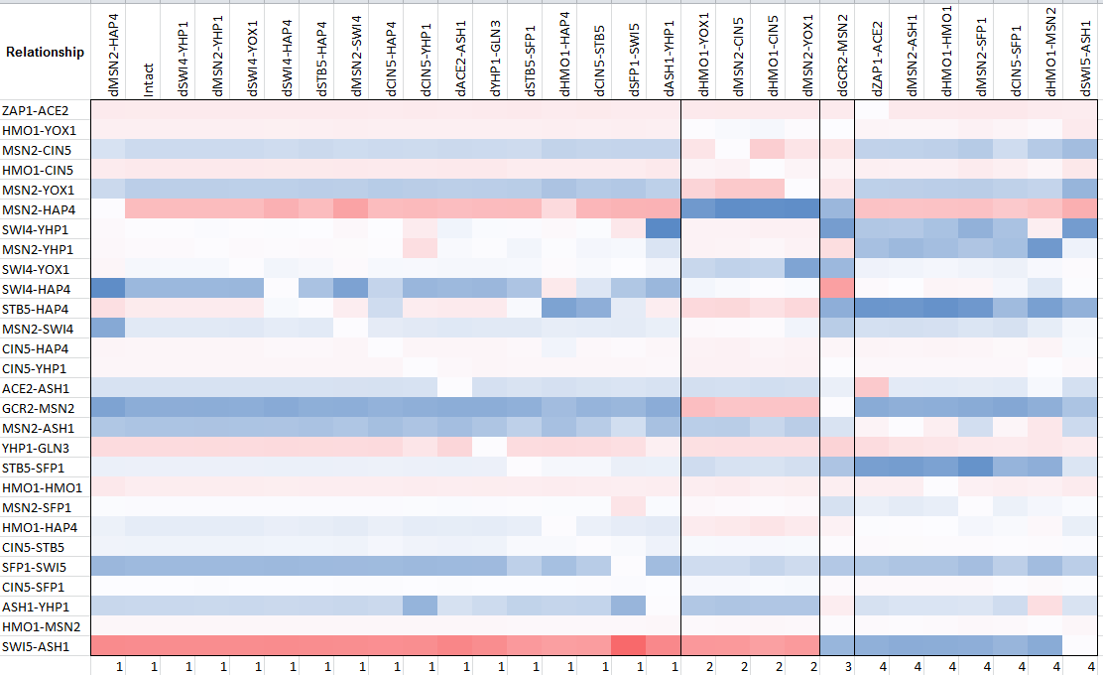
K means clustering: specified only 4 clusters

Slide 8
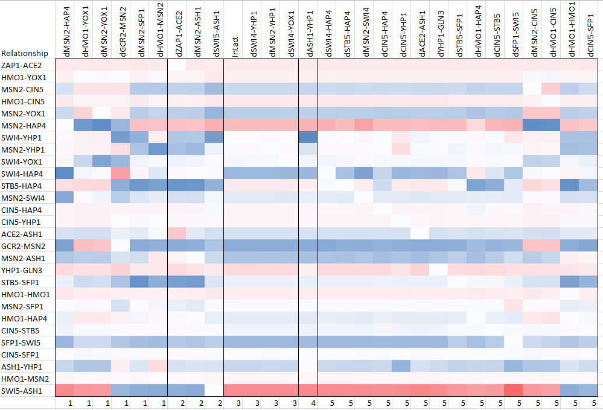
K means clustering: 5 clusters specified

Slide 9
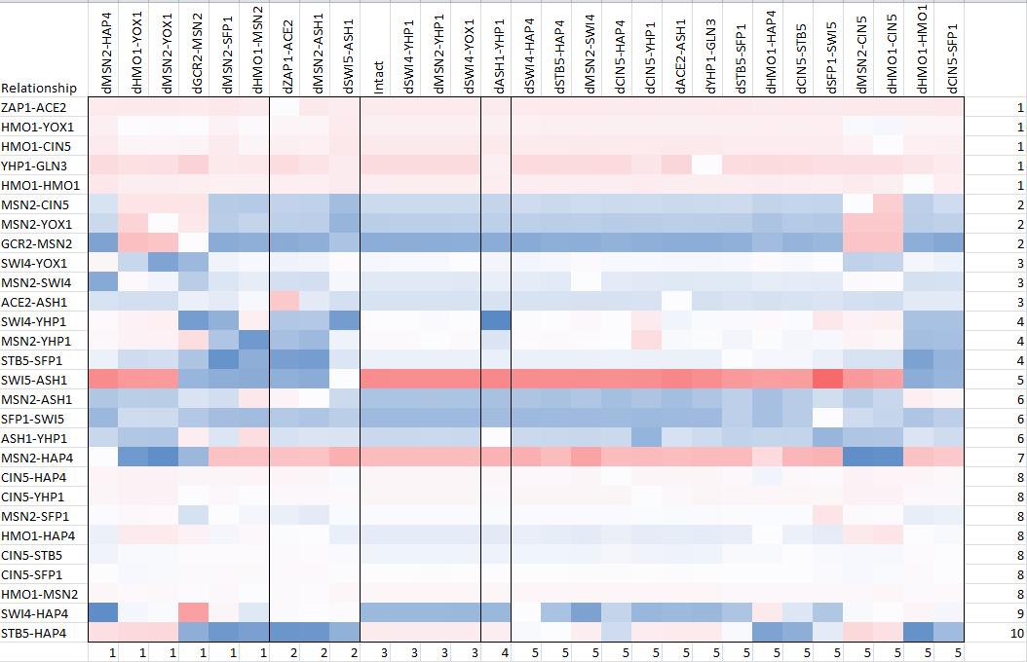

Slide 10
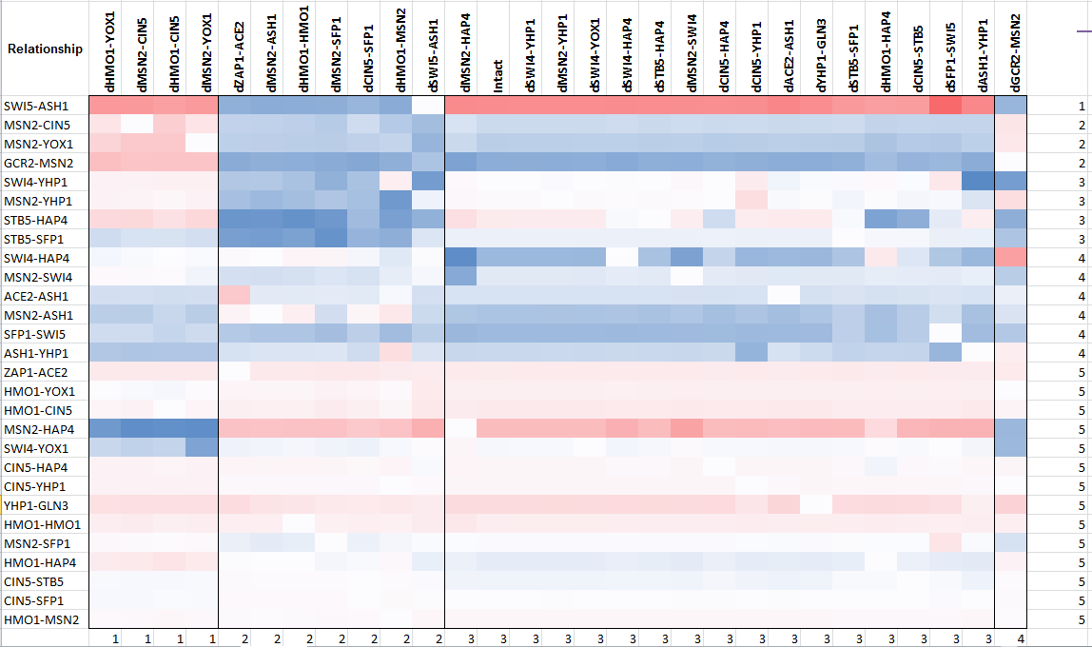
LK Heat Map: 4 clusters for edge deletion (x axis) and 5 clusters for edges (y axis)

Slide 11
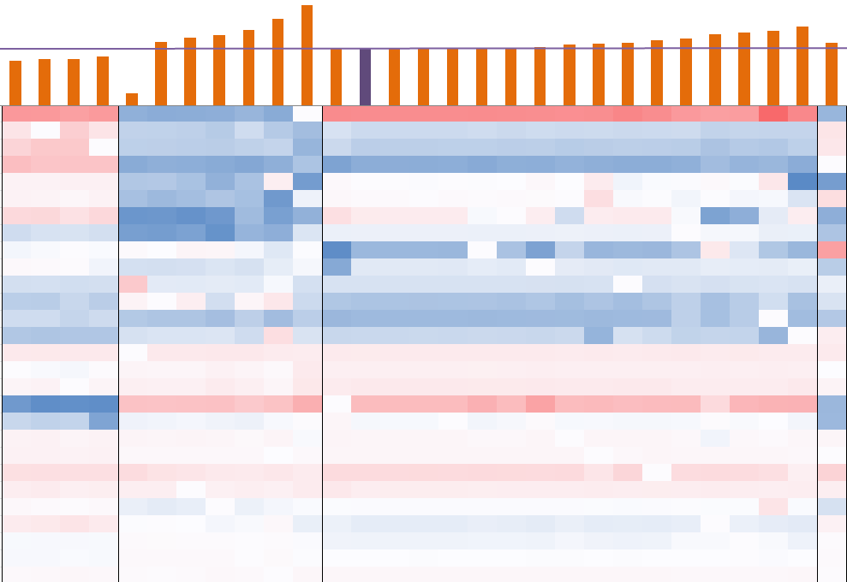

Slide 12
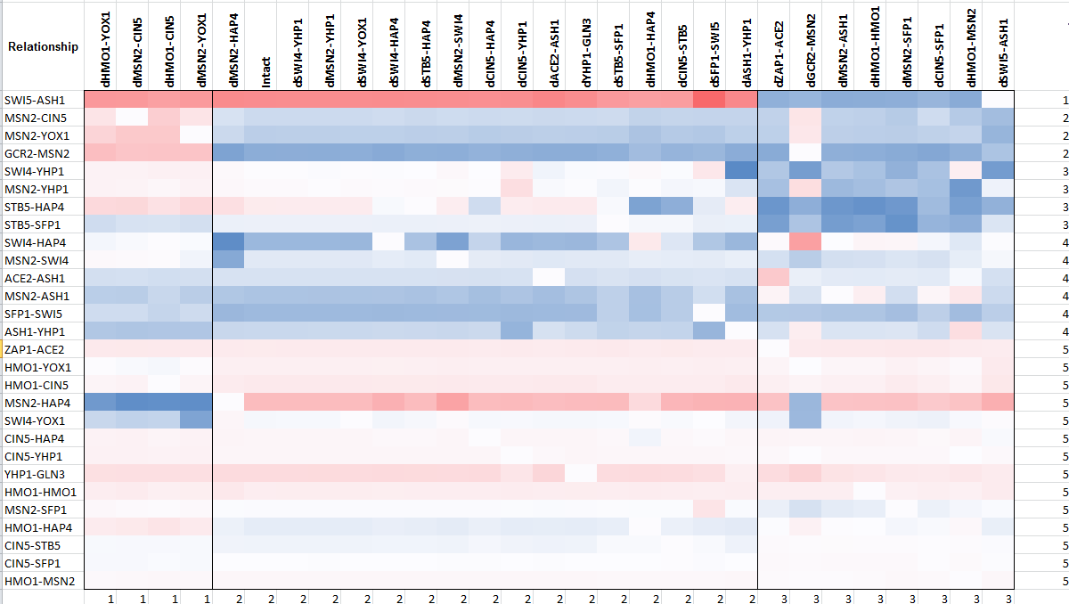
LK Heat Map: 3 clusters for edge deletion (x axis) and 5 clusters for edges (y axis)

Slide 13
Cluster 1 2 3

Slide 14
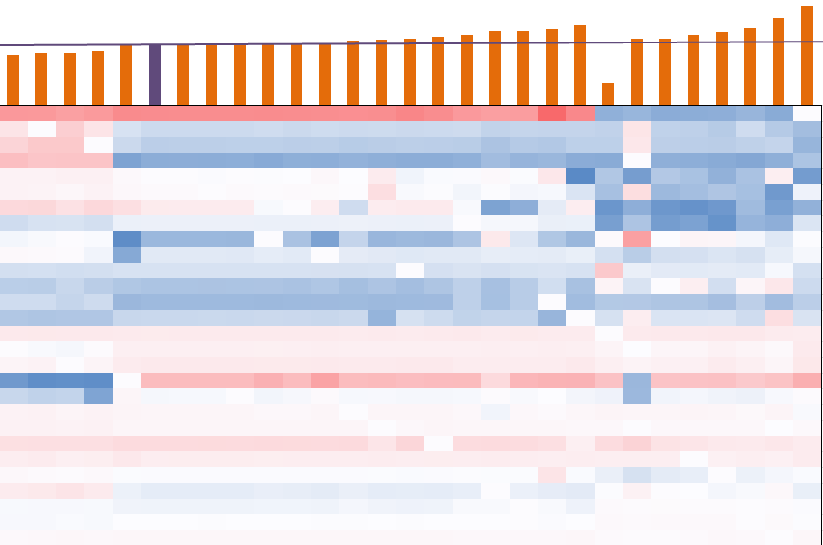

Slide 15
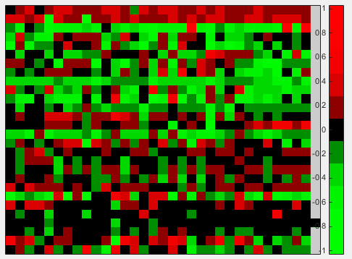
Strain-deletion analysis
Systematic deletion of strain data (wt, dCIN5, dGLN3, dHAP4, dHMO1, dZAP1)
Wt plus 1, 2, 3, or 4 strains
All-strain is the candidate db5 network
Heat map generated using MATLAB.
Data used were the optimized weights from the strain deletion model runs

Slide 16
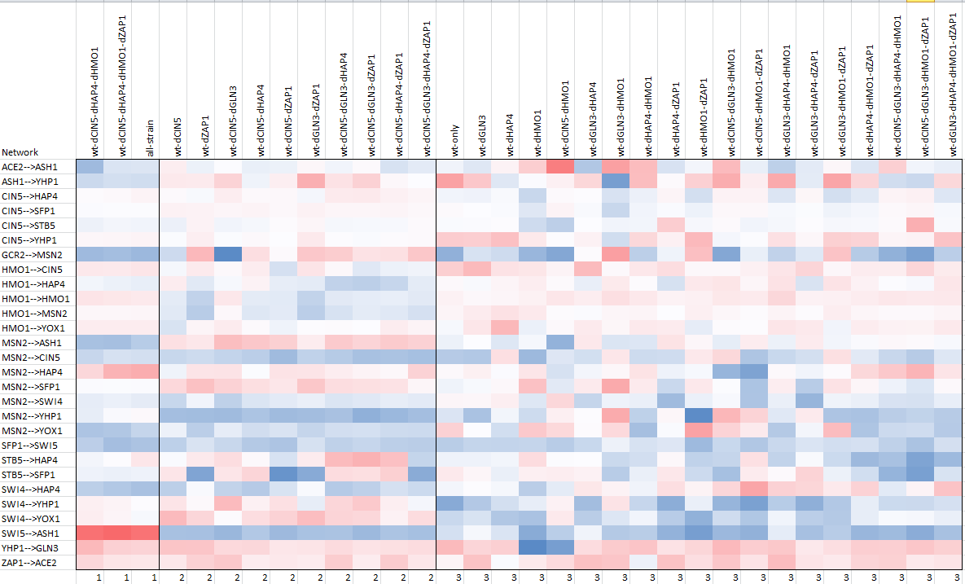
K means clustering: specified only 3 clusters

Slide 17
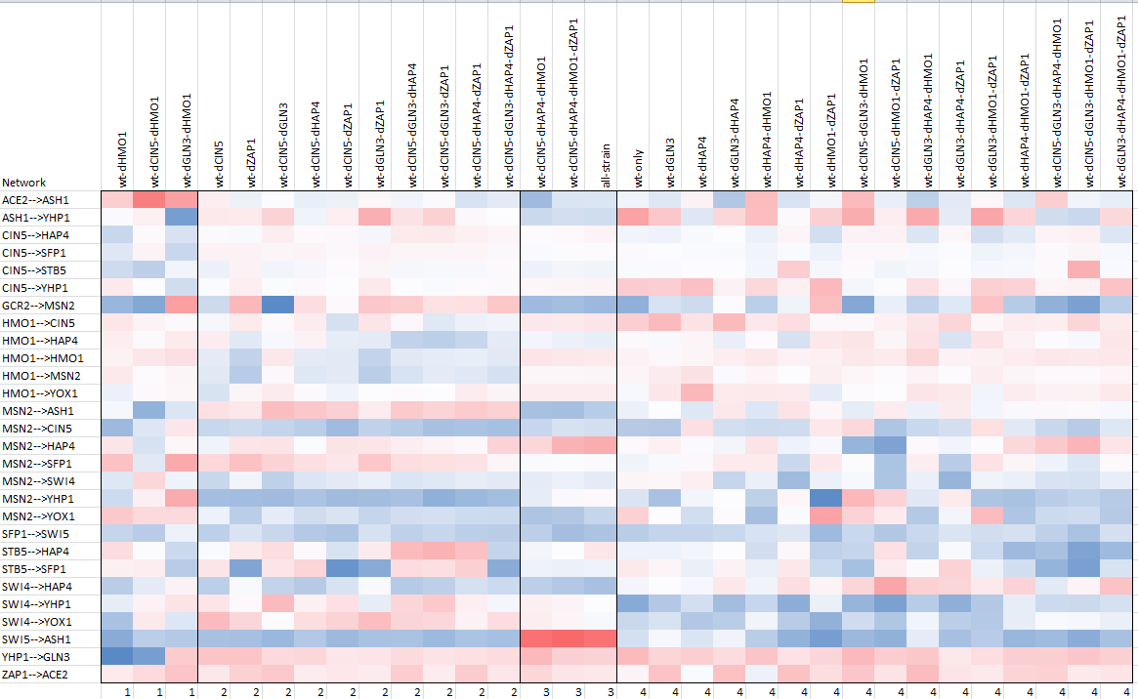
K means clustering: specified only 4 clusters

Slide 18
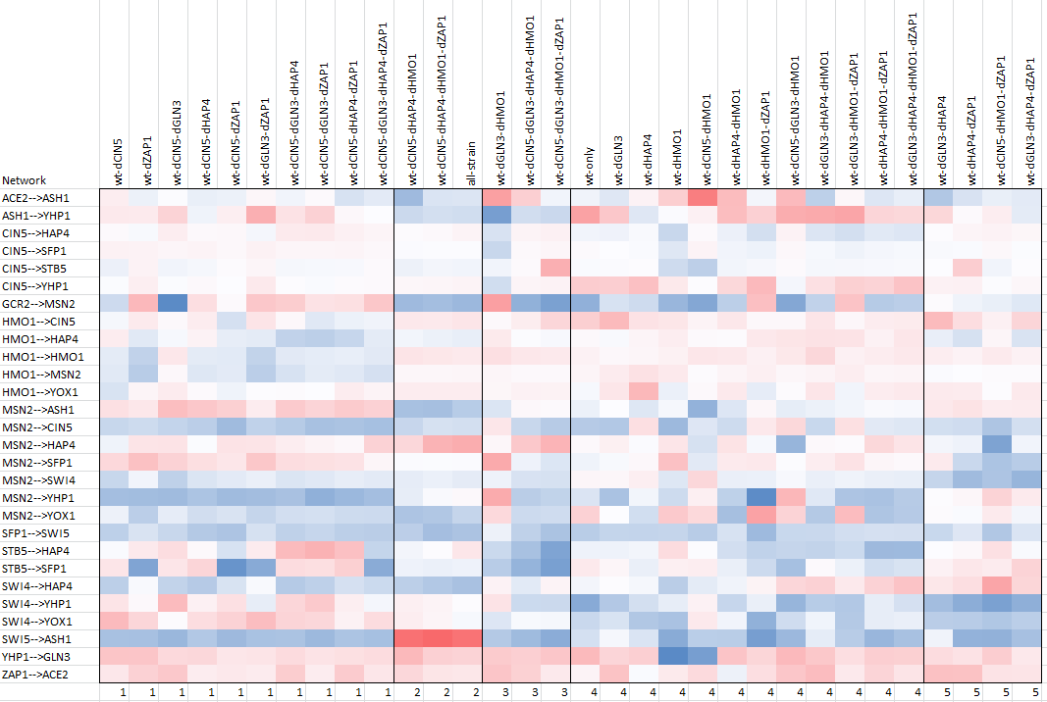
K means clustering: 5 clusters specified

Slide 19
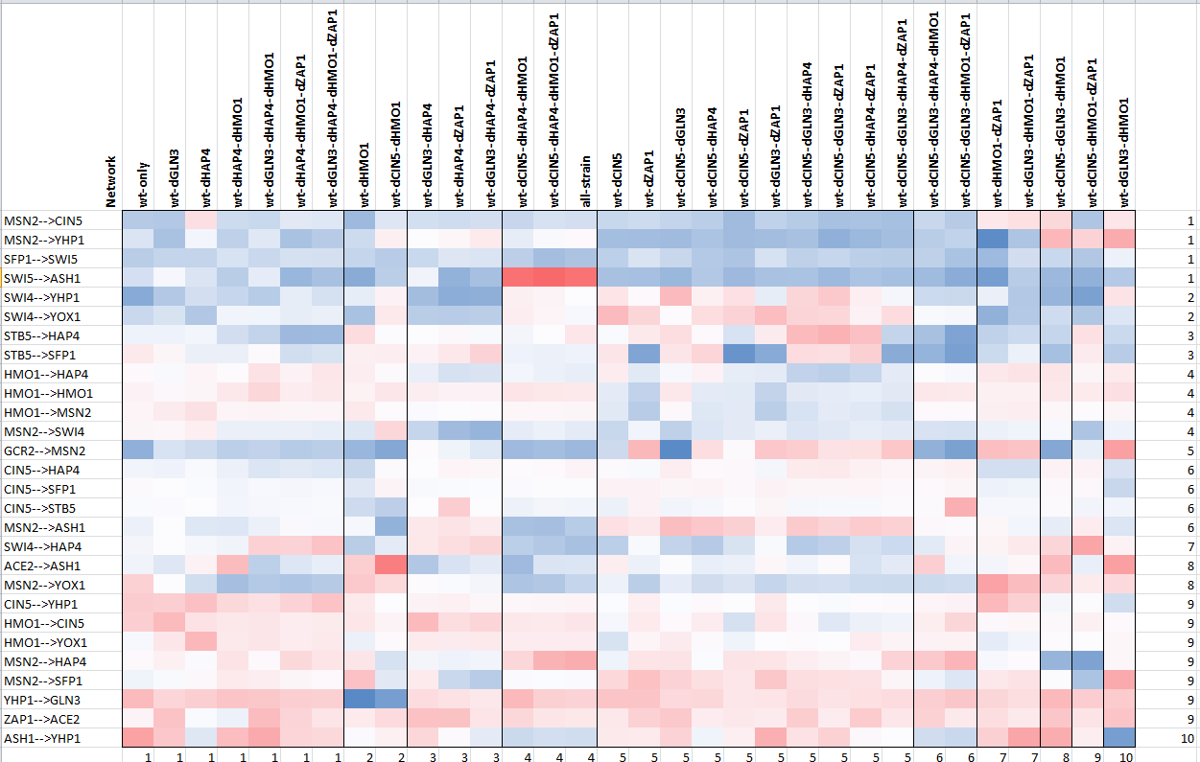
K means clustering: 10 clusters specified in both dimensions

Slide 20
